Slide 1
Python in Chemical Engineering
Ravi Shankar
200778

Slide 2
Assignments

Slide 3
Stoke’s law
Heat diffusion equation
Simulating flow and temperature profile in heated tube
Simulating flow and temperature profile through double pipe heat exchanger

Slide 4
Stoke’s law

Slide 5
Mathematical equation that expresses the drag force resisting the small spherical through a fluid medium
The Drag force Fd is equal to 6πrηv
The buoyancy force Fg is equal to ⁴/₃πr³ (d₁ − d₂)g
Terminal velocity is equal to ²/₉(d₁ − d₂)gr²/η

Slide 6
The drag force acting upward in resistance to the fall.
The buoyancy force acting downward.
Terminal velocity is the maximum velocity attainable by an object as it falls through a fluid.

Slide 7
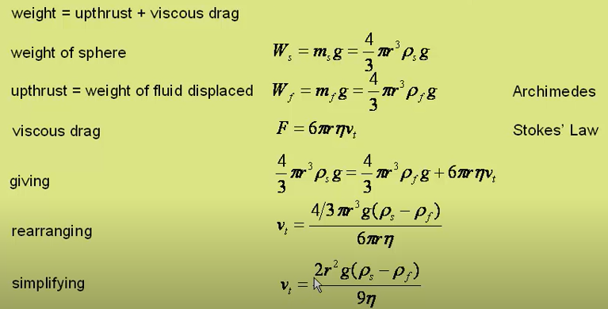
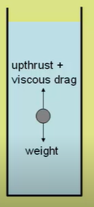
Derivation

Slide 8
Heat diffusion equation

Slide 9
Assumption
No energy generation
Steady state
Constant k

Slide 10







Derivation
Energy balance
.
Taylor series expansion
In x direction
Neglect the higher order term
Similarly in y direction
For steady state dT/dt=0

Slide 11
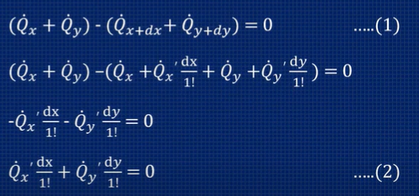
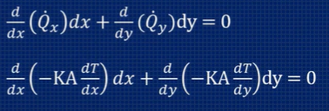
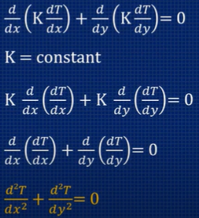

Energy balance(continued)

Slide 12
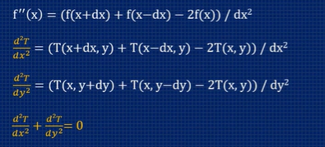

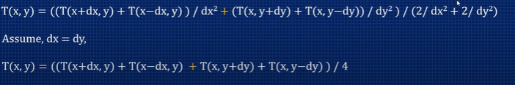
Taylor series expansion

Slide 13
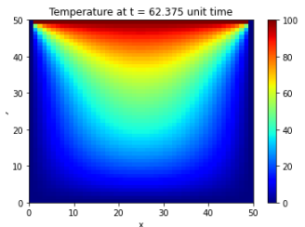
Final temperature profile

Slide 14
Simulating flow and temperature profile in heated tube

Slide 15
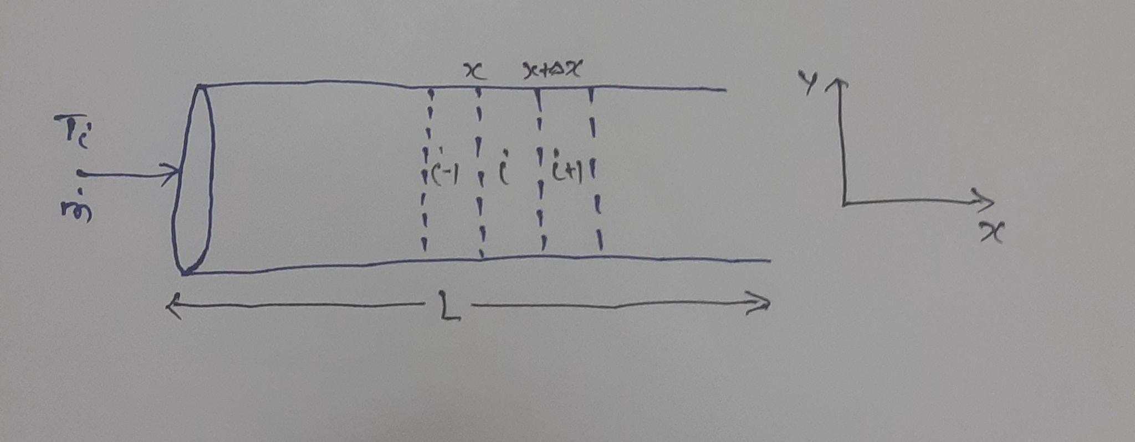
Derivation

Slide 16
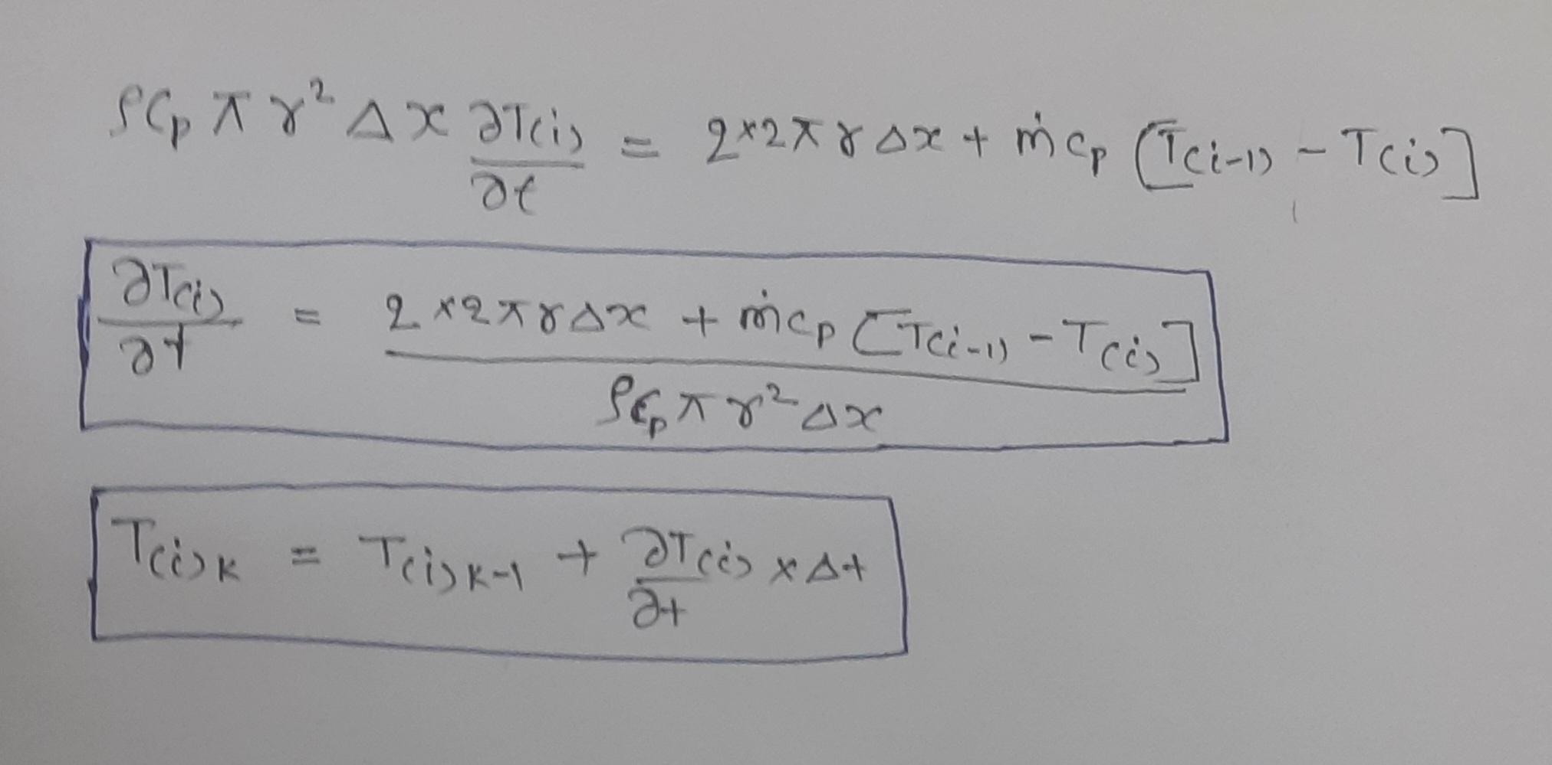
Energy balance
Accumulation = Energy (in + out) + Energy generation
Energy generation=0

Slide 17
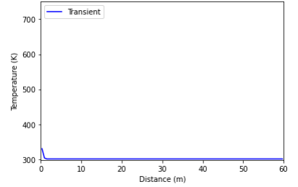
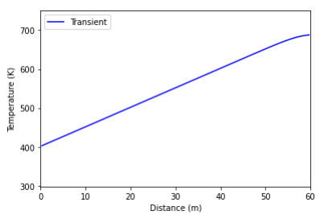
Temperature profile as function of time and space

Slide 18
Simulating flow and temperature profile through a double pipe heat exchanger

Slide 19
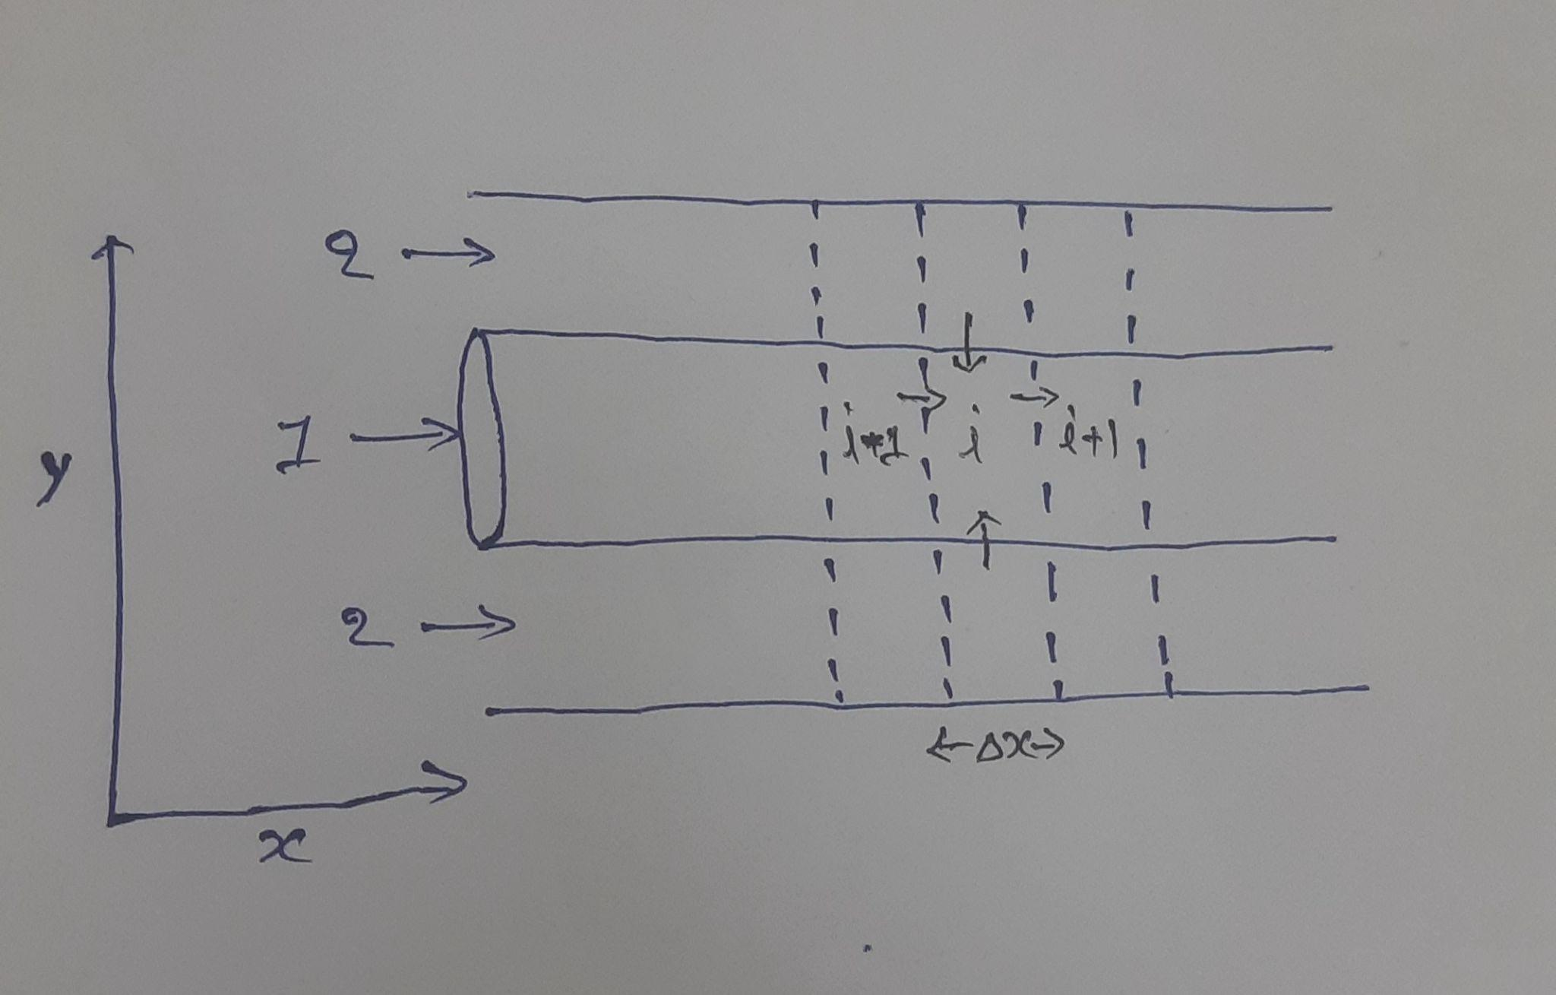
Derivation

Slide 20
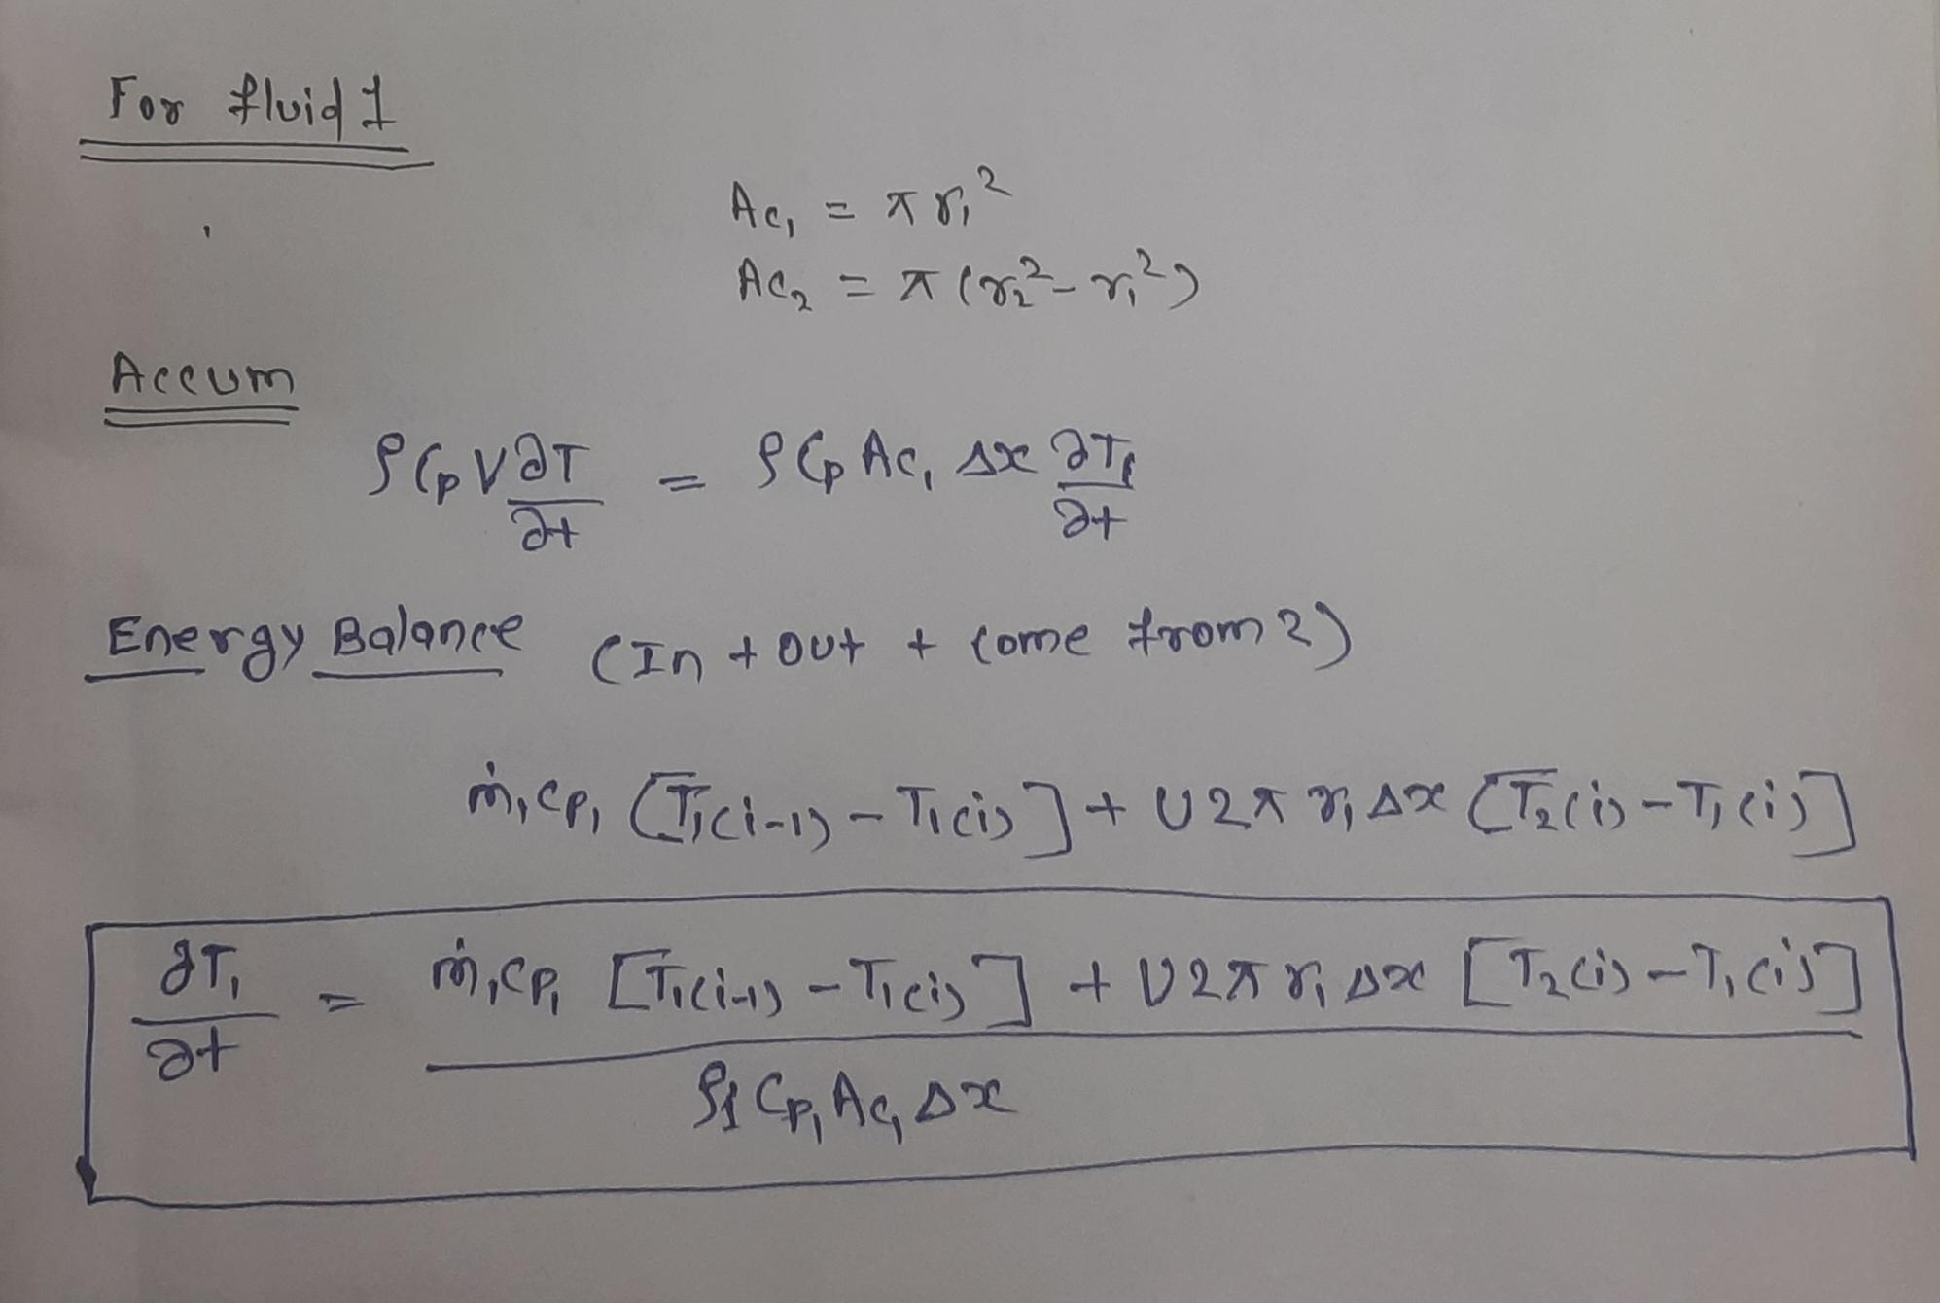

Slide 21
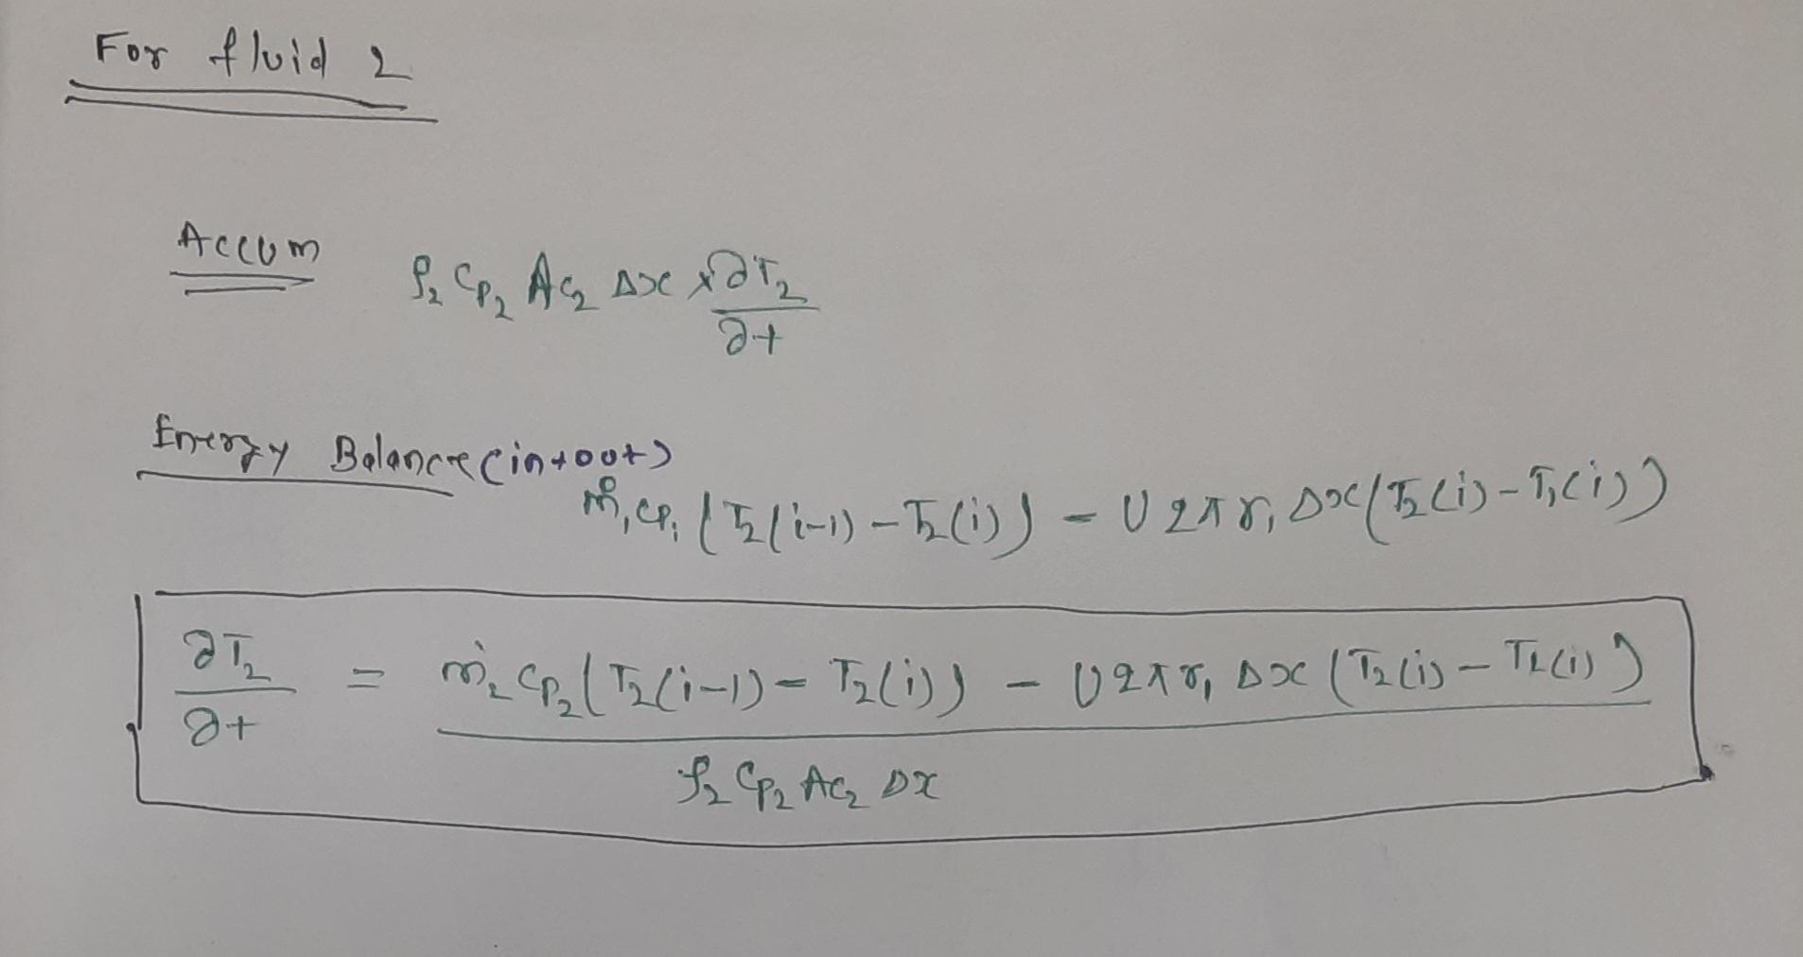

Slide 22
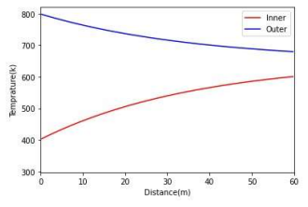
Temperature profile as a function time and space

Slide 23
Acknowledgement
I would like to thank our chemineers society for providing this project and also i would like to thank MR. Samanvay for their efficient mentorship and for teaching this project and for clearing our doubts and queries to our satisfaction, regarding the process and progress of this project.

Slide 24
Thankyou

